Slide 1


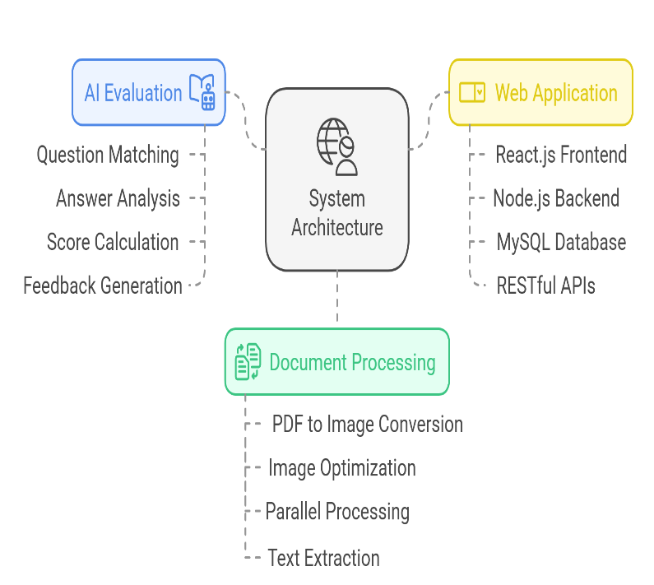
Global Academy of Technology
Department of Artificial Intelligence Machine Learning
Automated Answer Sheet Evaluation Using GenAI
Abstract
This research introduces an innovative solution for automated evaluation of answer sheets in educational assessment, using Generative AI and the Gemini-1.5 model. The system includes advanced PDF processing, image optimization, parallel processing, text extraction, semantic matching algorithms, and real-time progress tracking. It reduces assessment time by 2 minutes per paper and maintains a correlation of 85-90% with manual grading standards. It is particularly useful for large-scale assessments.
Methodology
Scope of the research
System Architecture Overview
• Comprises frontend, backend, and database layers.
• Python modules handle core processing tasks.
Document Processing Pipeline
• Accepts PDF documents converted to high-quality images.
• Optimizes images using ImageOptimizer class.
Parallel Processing Implementation
• Utilizes multiple Gemini AI API endpoints running parallelly for better optimization.
AI-Powered Evaluation
• Leverages Gemini-1.5 model for Question Paper Analysis, Answer Key Processing, Student Response Analysis, Score Calculation, and Feedback Generation.
Web Application Integration
• Uses React.js frontend, Node.js backend, MySQL database, and RESTful API architecture.
The automated answer sheet evaluation system is set to undergo significant enhancements, improving language comprehension, mathematical expression handling, and diagram analysis. The system will focus on caching mechanisms, parallel processing, and robust error handling. It will support multiple languages, provide deeper evaluation patterns, and offer custom templates. Integration possibilities include seamless connectivity with Learning Management Systems.
Introduction
Conclusion
The research demonstrates the use of Generative AI technologies in automated answer sheet evaluation, enhancing efficiency and accuracy. The system uses advanced parallel processing techniques and sophisticated algorithms, making it suitable for small-scale classroom assessments and large-volume scenarios. It generates comprehensive feedback, enhances educational value, and is cost-effective. Its adaptability and extensibility make it suitable across various educational contexts, laying the groundwork for future advancements in automated assessment technologies.
Educational institutions worldwide face challenges in evaluating large student responses, including format variability, question matching, partial credit, and managing large submission volumes. The research aims to develop an automated system for efficient answer sheet evaluation, robust document processing, Generative AI for intelligent response analysis, a scalable evaluation framework, and detailed feedback and performance analytics, resulting in time efficiency, consistency, scalability, faster results, and fair assessment.
References
Google. (2024). "Gemini API Documentation and Implementation Guide"
Smith, J. et al. (2023). "Advanced Automated Assessment Systems in Modern Education"
Kumar, R. (2023). "AI-Powered Educational Technology: Transforming Assessment Methods"
Zhang, L. (2024). "Applications of Natural Language Processing in Educational Assessment"
Brown, M. (2023). "Machine Learning Applications in Educational Evaluation Systems"
Davis, P. (2024). "Parallel Processing Techniques in Educational Technology"
Wilson, K. (2023). "Database Design for Educational Assessment Systems"
Thompson, R. (2024). "Web Application Architectures for Educational Platforms"

